Slide 1

Department of computer Application University Institute of Technology Rajiv Gandhi Proudyogiki VishwaVidyalaya
A MINOR PROJECT PRESENTATION ON
TASK SCHEDULER APP
SUBMITTED TO : SUBMITTED BY:
DEPARTMENT OF COMPUTER APPLICATION AMRITA SONI PROJECT GUIDED BY NIDHI VERMA
MR. JAY NARAYAN THAKRE ABHISHEK ARYA
ASSISTANT PROFESSOR CLASS :- MCA 3rd SEM

Slide 2
Index
Introduction
Features
Modules
Tools and Technologies used
Server side Technologies
Client side Technologies
Hardware Requirements
Use Case Diagram
Output Screens
Pros & Cons
Conclusion

Slide 3
Introduction
Task Scheduler is a web app on which we can schedule our daily routine task . It is a class that schedules and automatically fires events at a time you specify and the object of this app is to manage various tasks as per the set deadline . It helps us to maintain our day-to-day tasks or list everything that we have to do. It enhances our efficiency to work it helps us to be punctual in our day-to-day life . We need to schedule tasks not only daily ,weekly, we need a combination of them.

Slide 4
Features
Easy Accessibility:
Records can be easily accessed and store and other information respectively.
User Friendly:
The App will be giving a very user-friendly approach for all user.

Slide 5
Efficient and reliable:
Maintaining the all secured and database on the server which will be accessible according the user requirement without any maintenance cost will be a very efficient as compared to storing all the customer data on the spreadsheet or in physically in the record books.
Easy maintenance:
Task scheduler design as easy way. So maintenance is also easy.

Slide 6
Modules used in app
User Registration Module
1. Create a JavaBeans - User.java
2. Configure JDBC Connection- JDBC Utils.java
3. DAO Layer - UserDao.java
4. Controller Layer - UserController.java
5. View Layer - register.jsp

Slide 7
Login Module
1. Create a JavaBeans - LoginBean.java
2. DAO Layer - LoginDao.java
3. Controller Layer - LoginController.java
4. View Layer - login.jsp

Slide 8
Tools and technologies
Server-side tools and technologies used
JDK 1.8 or later
Servlet
Tomcat Server
My SQL Database

Slide 9
Client-side tools and technologies used
HTML/CSS/JavaScript
Eclipse IDE
Bootstrap
JSP( Java server Page)

Slide 10
Hardware Requirements
i3 Processor
2-GB RAM or Above
200 GB Hard-disk or Above

Slide 11
Use case diagram
Registration/Login
to dor list
et Get todo listto do list
User
Edit in todo list
Get User list
RLog Out

Slide 12
Get Database
Registration/Login
to dor list
Get todo list
to dor list
et dEdit in todo list
o list
Admin
Edit in Database
Get User list
RLog Out

Slide 13
Output screens

Slide 14
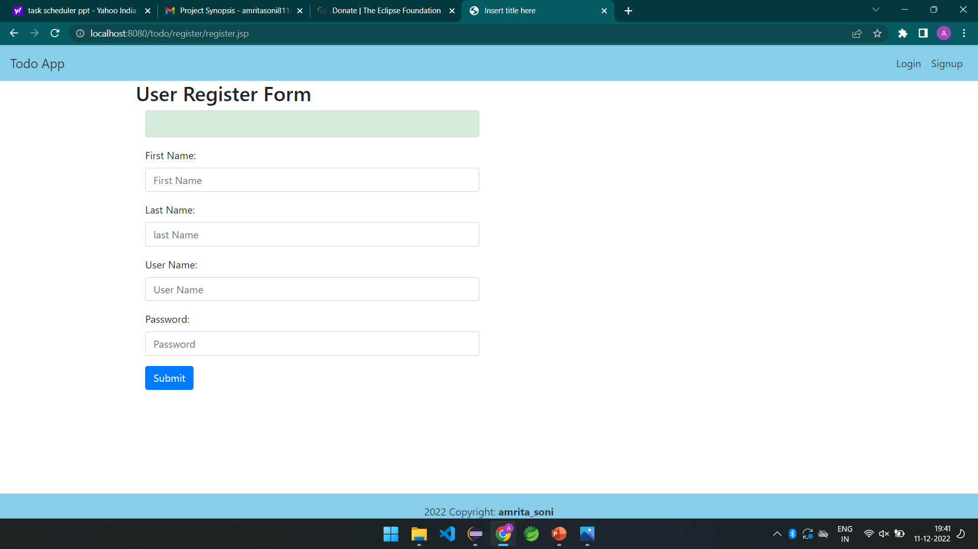
Registration page

Slide 15
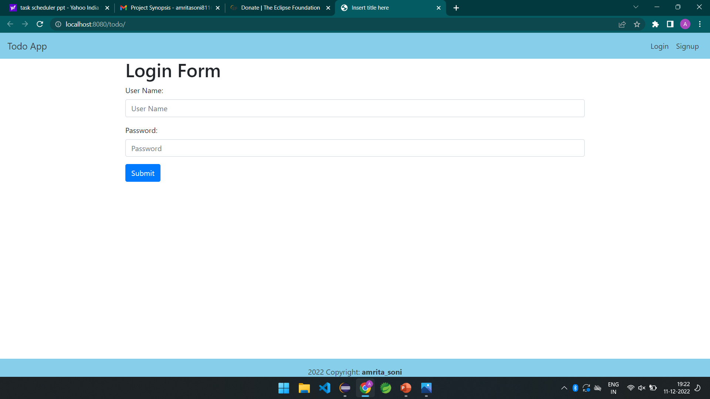
Login page

Slide 16
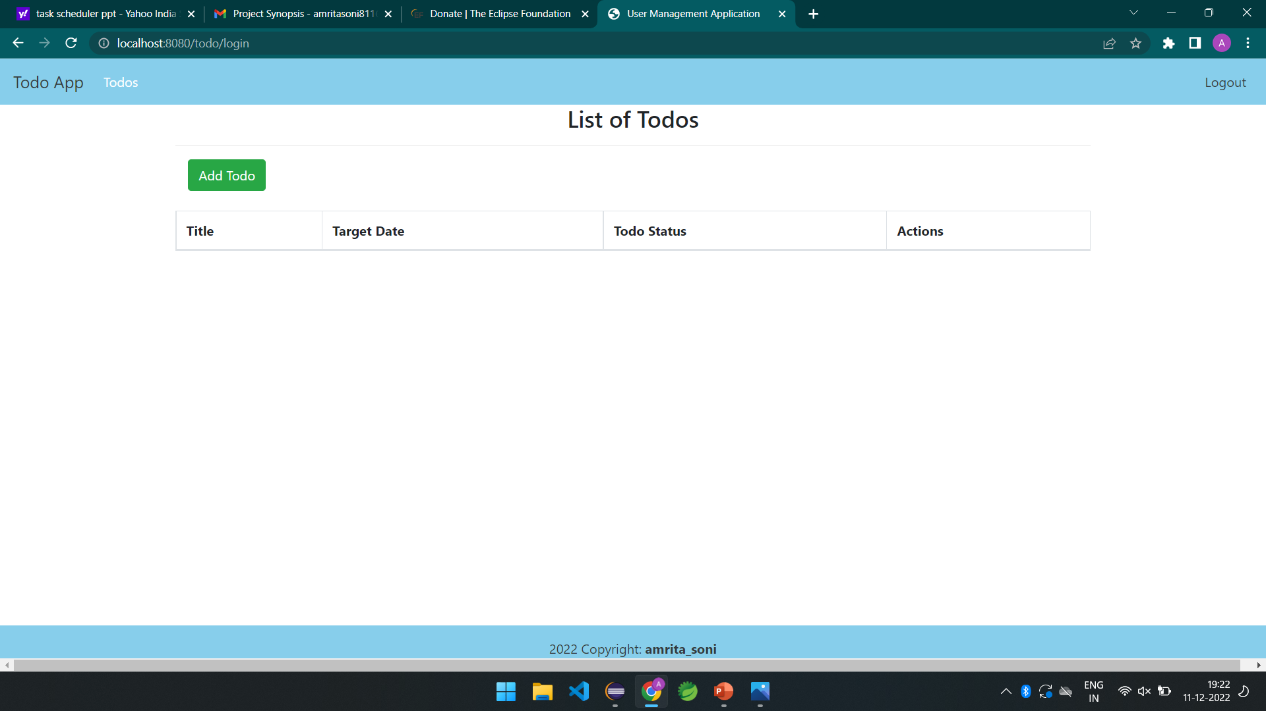
Add Tasks

Slide 17
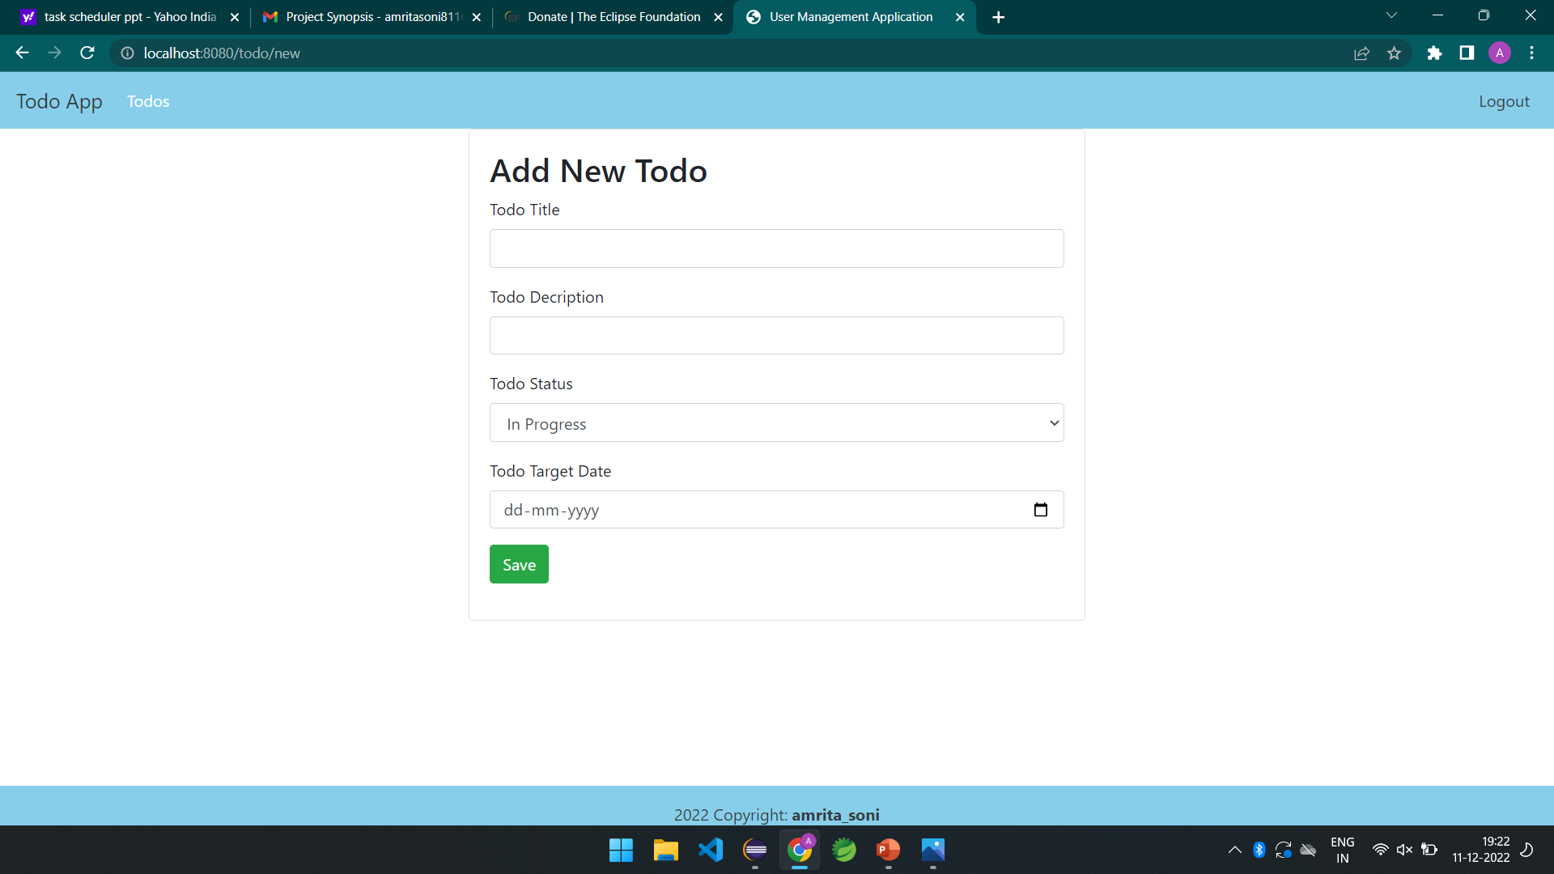

Slide 18
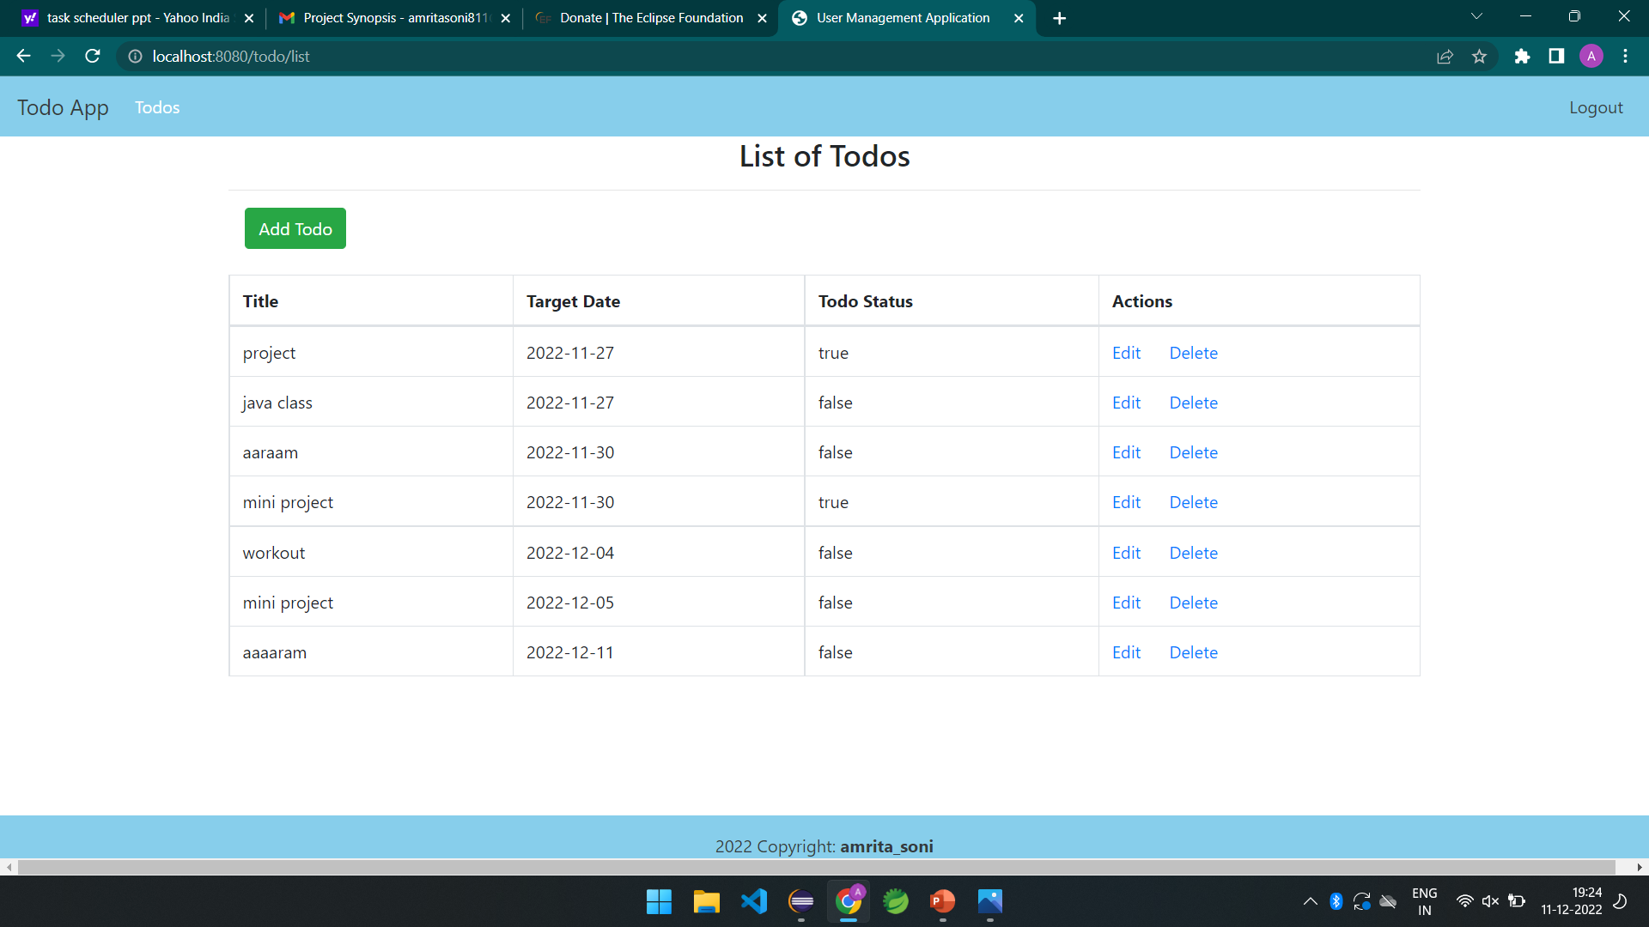
Final view

Slide 19
Pros & cons of task scheduler app

Slide 20
Pros
It provide structure and a clear game plan.
It gives you a sense of control and accomplishment.
It create order. A Task Scheduler is a good way to organize and prioritize your tasks as well as break them down into smaller doable items.
They provide accountability- The act of creating a list and having it right in front of you holds you accountable to get it done. It’s hard to deny that you have tasks to complete when they are staring back to remind you

Slide 21
cons
They don't accurately measure how long each task takes to complete. Not knowing which tasks will take longer than planned can blow up your whole to-do list; again causing stress and uncertainty.
Most of us end up doing the easy tasks first and procrastinate on the complex ones. When you end up doing the easy stuff first, the important tasks are still left undone which defeats the purpose - to be efficient and productive.
Lack of elaboration. To-do lists don't provide enough information to determine what to work on first or how to prioritize properly, especially the day after you’ve compiled your list. As a result, you spend more time trying to figure out what to do and when.

Slide 22
conclusion
This was our project of System Design about “TASK SCHEDULER” developed as a web application developed in Java programming language. The Development of this system takes a lot of efforts from us. We think this system gave a lot of satisfaction to all of us. Though every task is never said to be perfect in this development field even more improvement may be possible in this application. We learned so many things and gained a lot of knowledge about development field. We hope this will prove fruitful to us

Slide 23
Thank you

